Slide 1
AWS Compute Services
Rakesh Acharya
Rajdeep Das

Slide 2
EC2 Overview

Slide 3
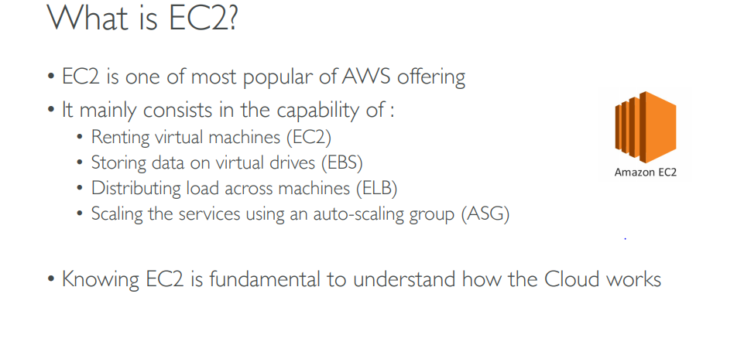

Slide 4
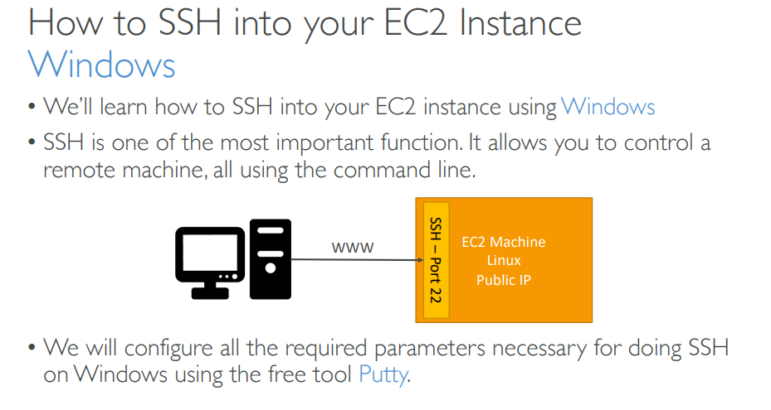

Slide 5
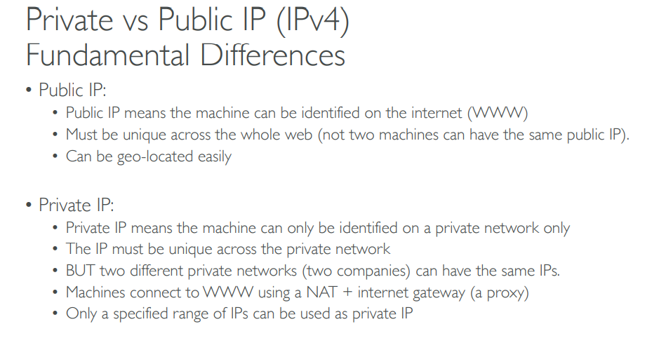

Slide 6
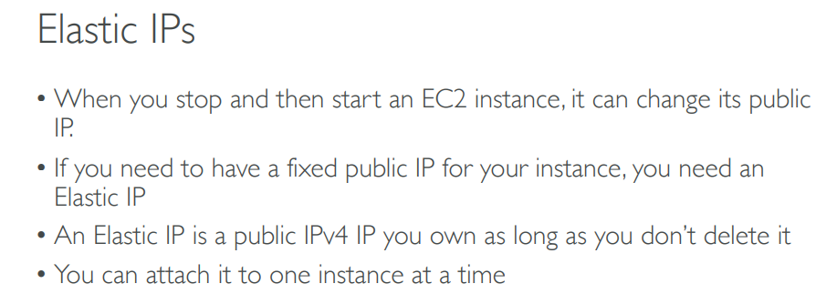
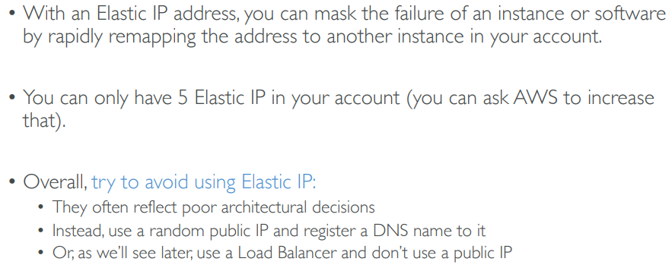

Slide 7
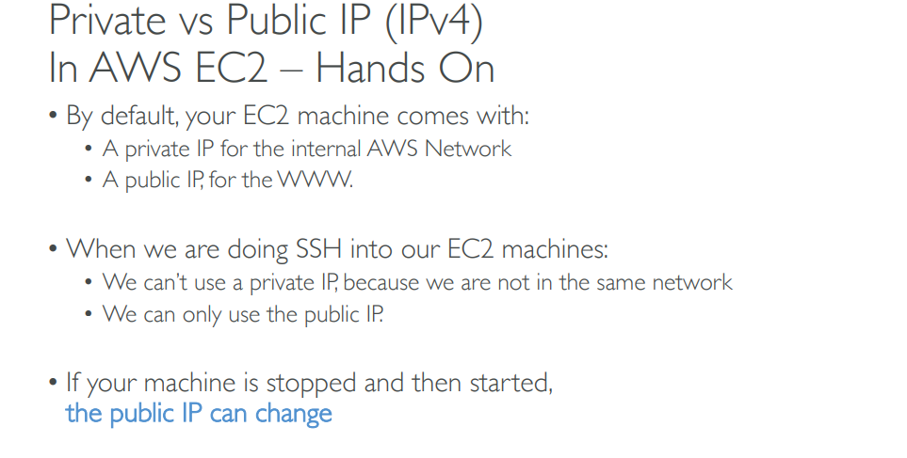

Slide 8
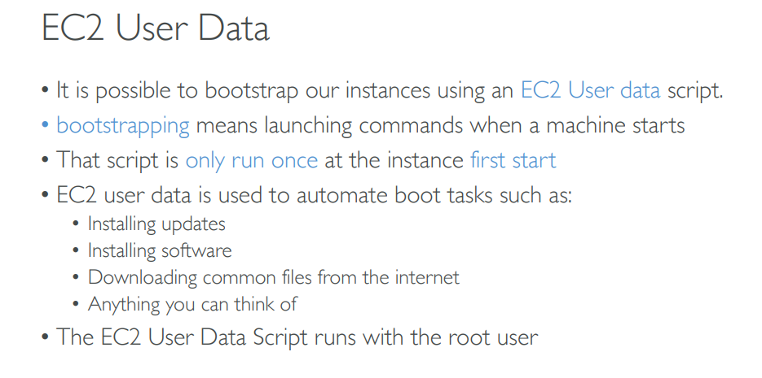

Slide 9
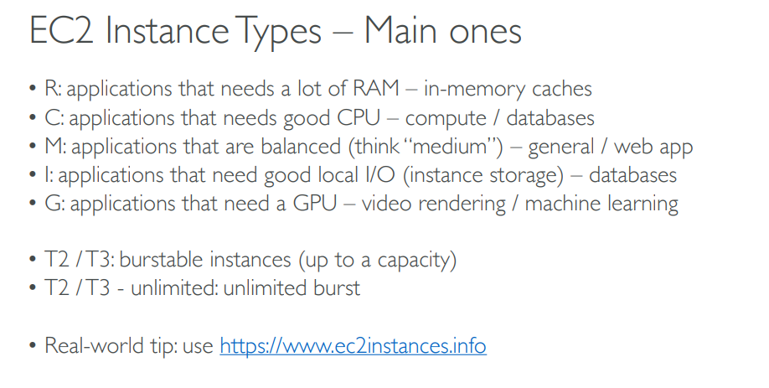

Slide 10
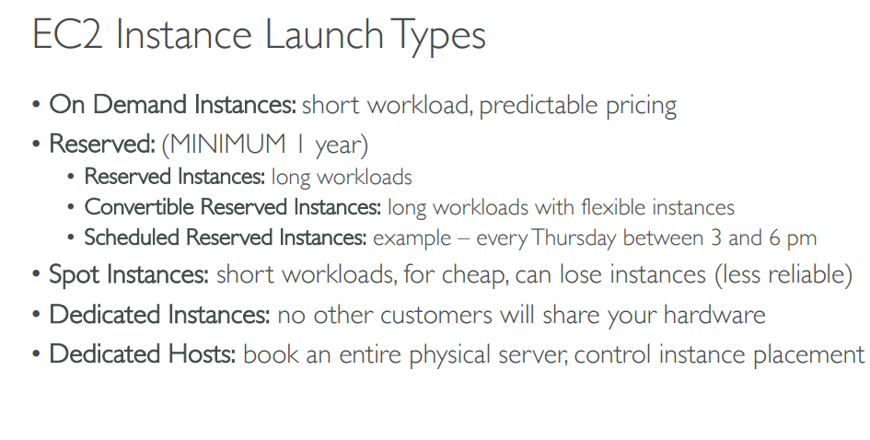

Slide 11
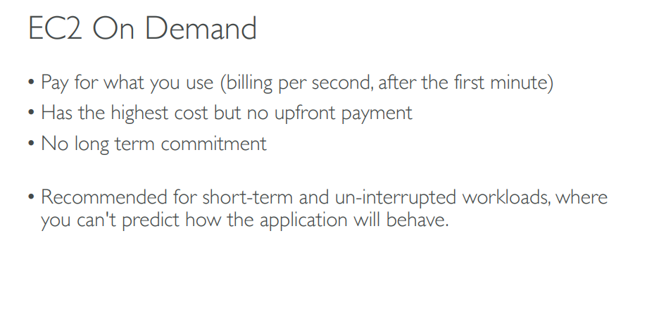

Slide 12
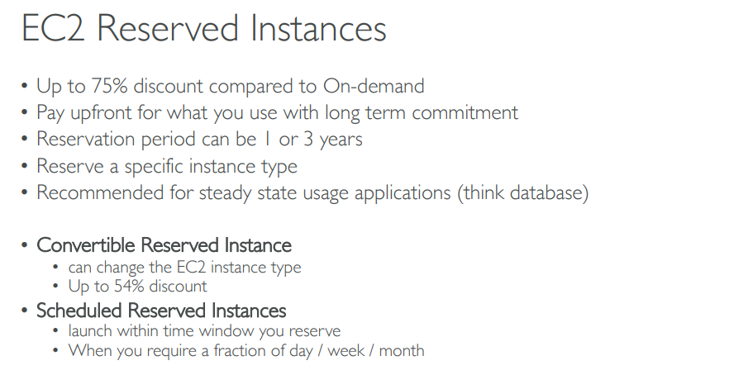

Slide 13
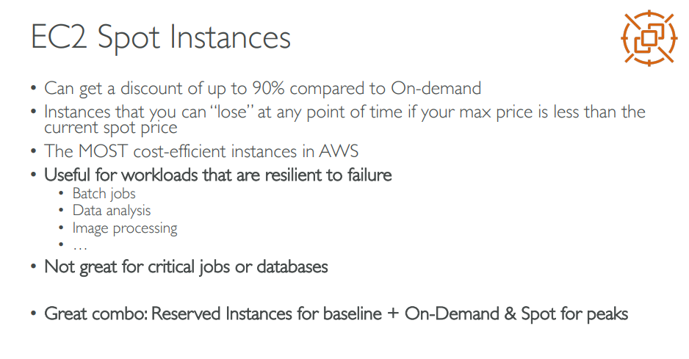

Slide 14
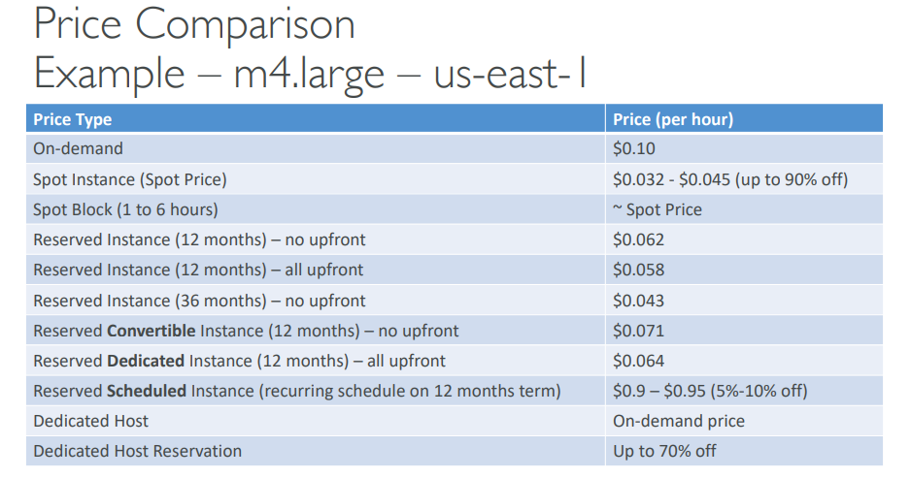

Slide 15
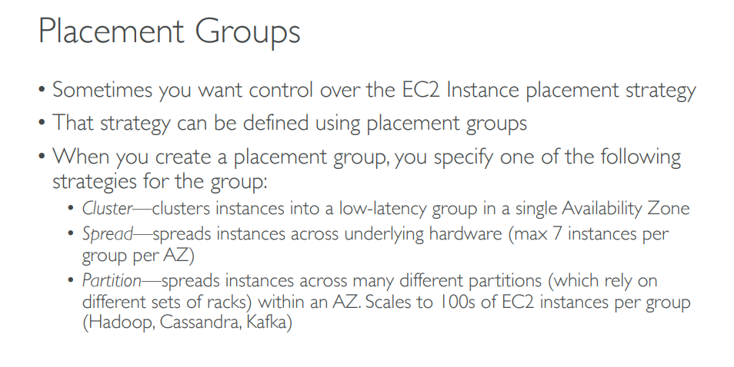

Slide 16
Session Manager

Slide 17
What is Session Manager
Session Manager is a fully managed AWS Systems Manager capability that lets you manage your Amazon EC2 instances, on-premises instances, and virtual machines (VMs) through an interactive one-click browser-based shell or through the AWS CLI.
Session Manager provides secure and auditable instance management without the need to open inbound ports, maintain bastion hosts, or manage SSH keys.

Slide 18
Elastic Block Storage

Slide 19
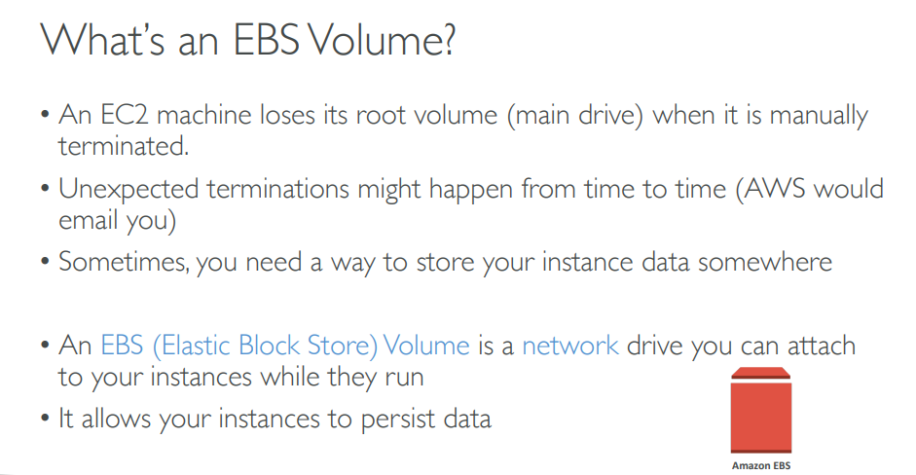

Slide 20
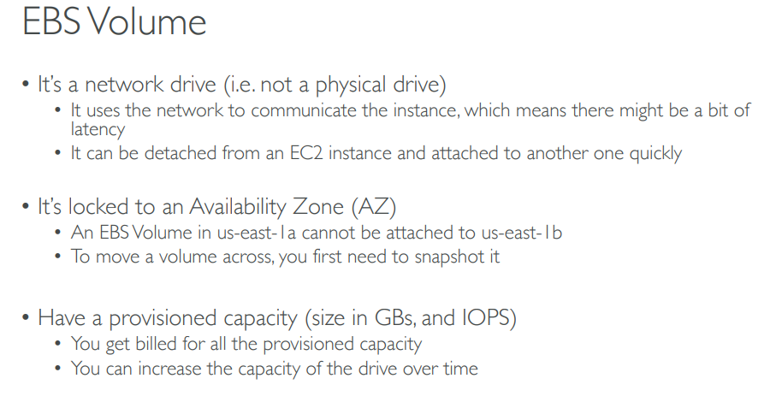

Slide 21
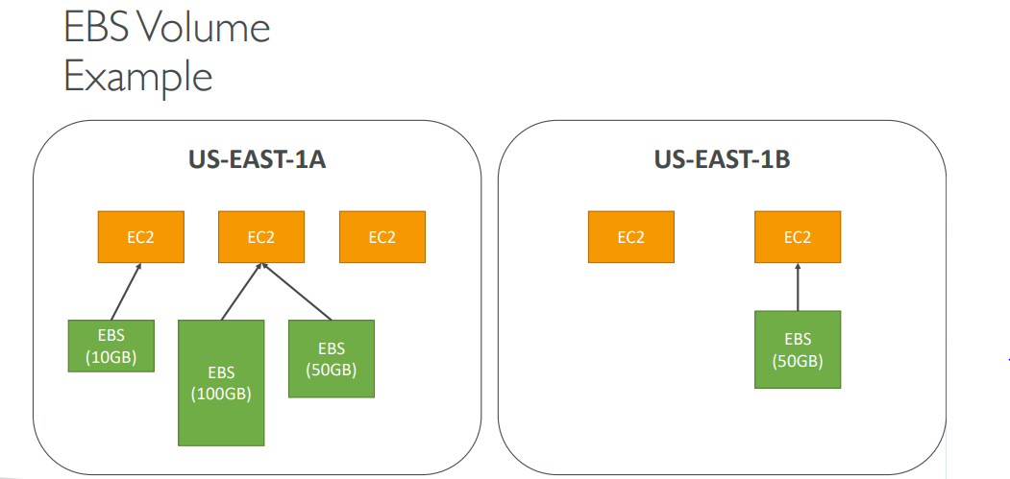

Slide 22
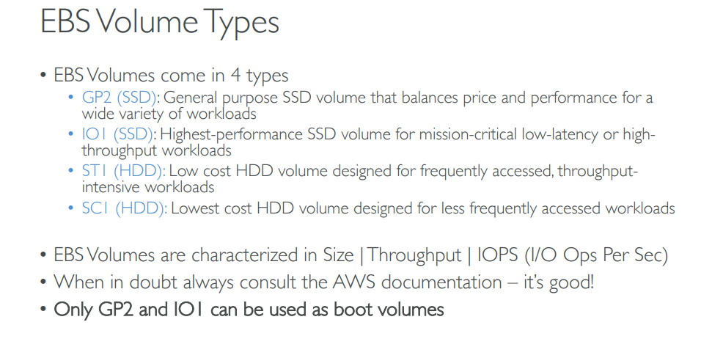

Slide 23
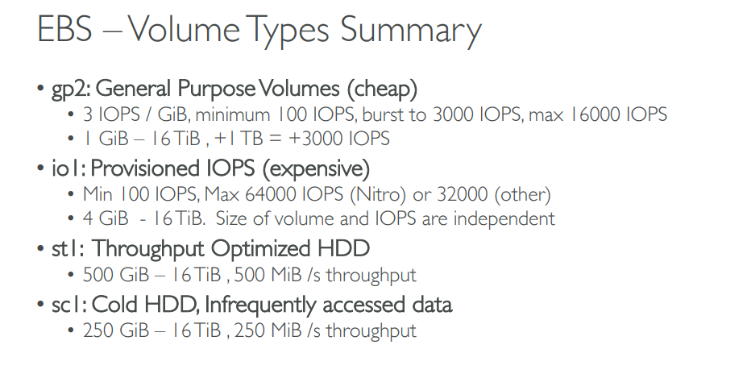

Slide 24
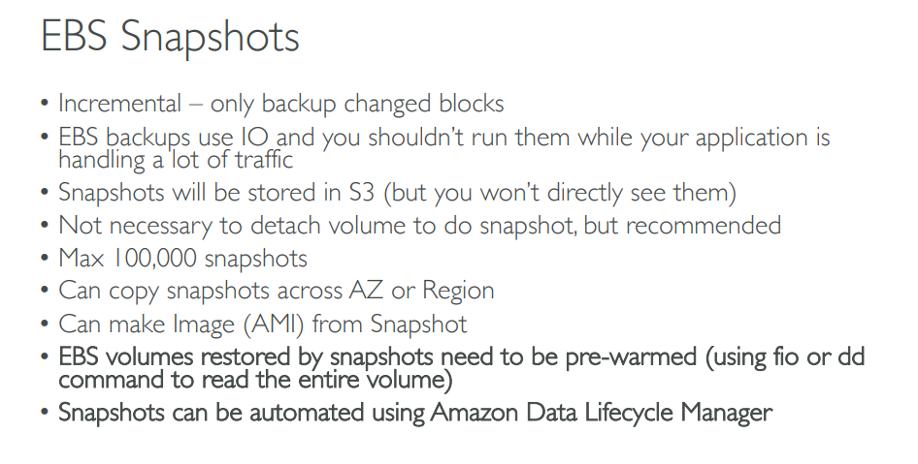

Slide 25
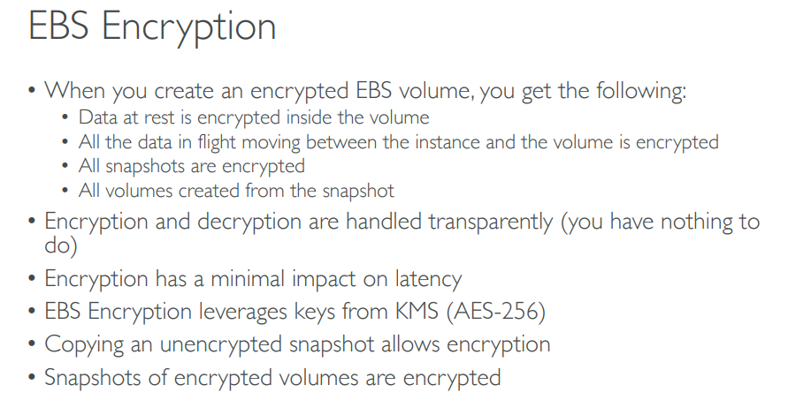

Slide 26
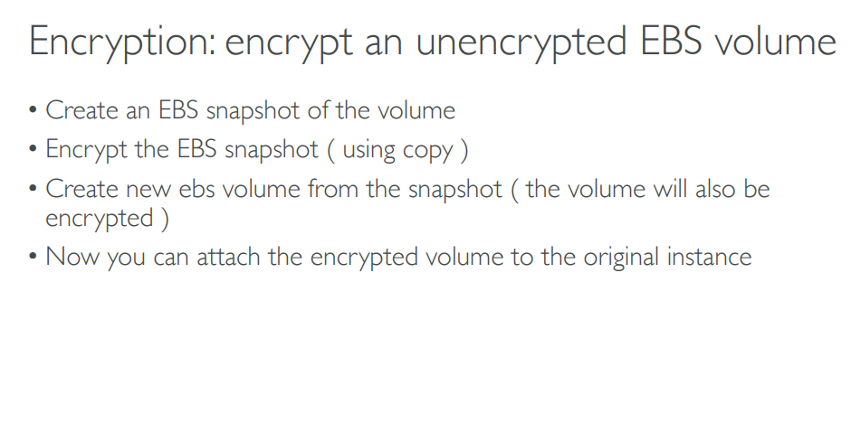

Slide 27
Elastic Load Balancer

Slide 28
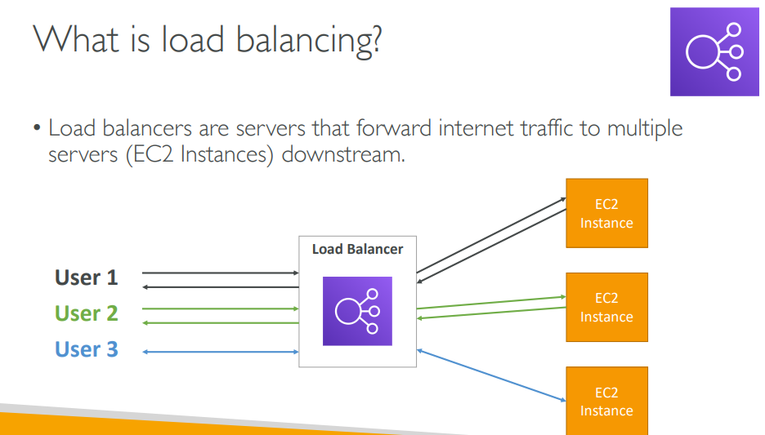

Slide 29
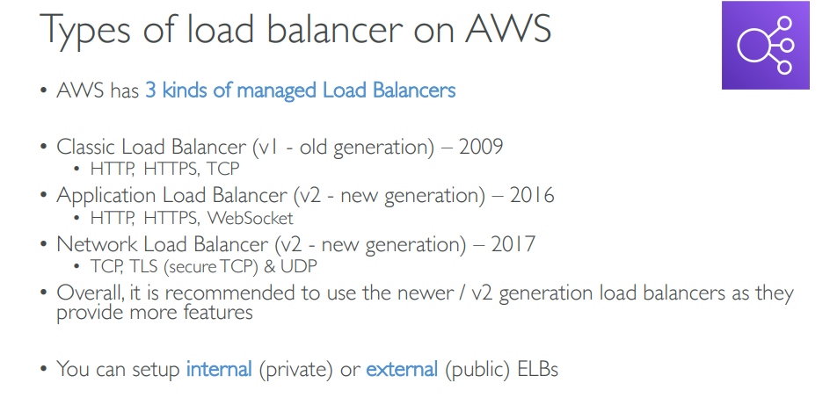

Slide 30
Auto Scaling Group

Slide 31
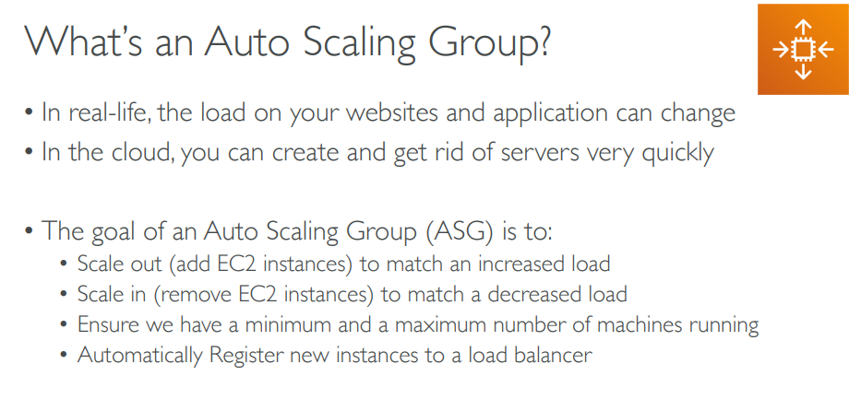

Slide 32
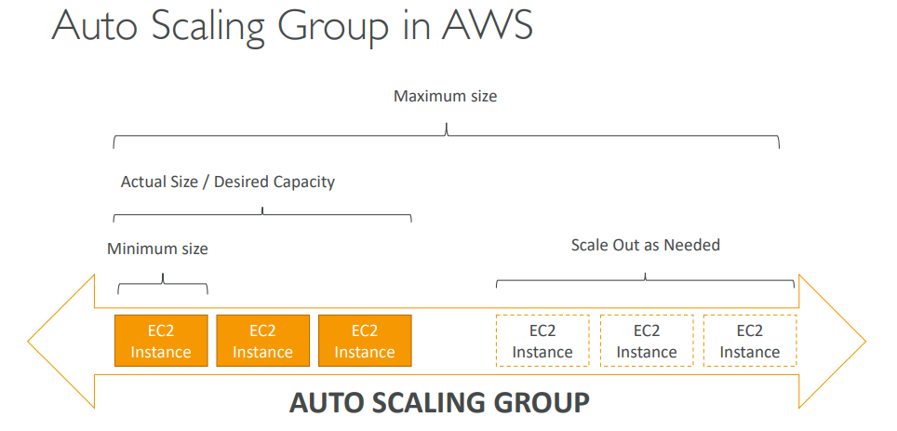

Slide 33
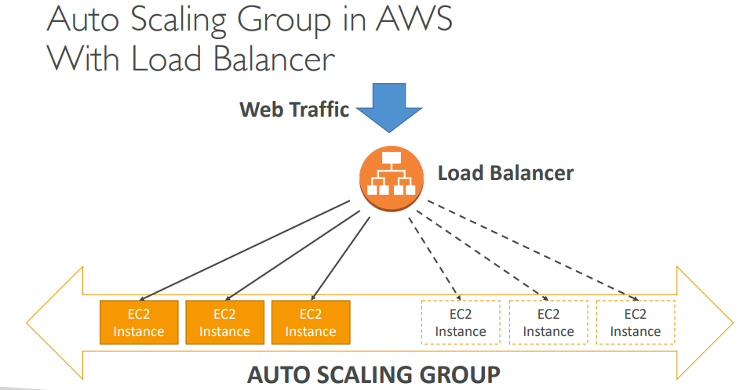

Slide 34
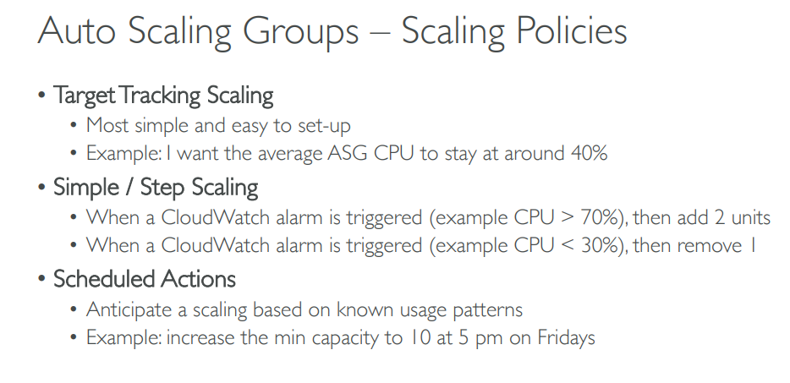

Slide 35
Lambda Overview

Slide 36
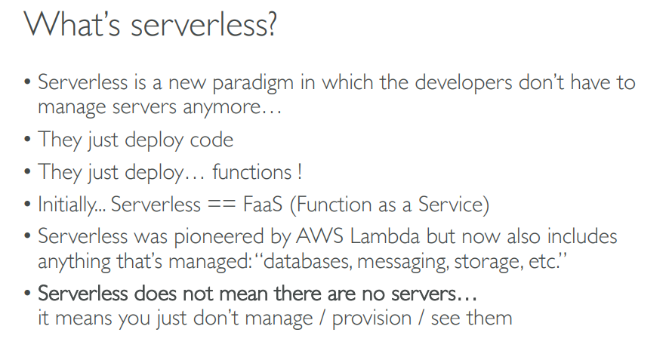

Slide 37
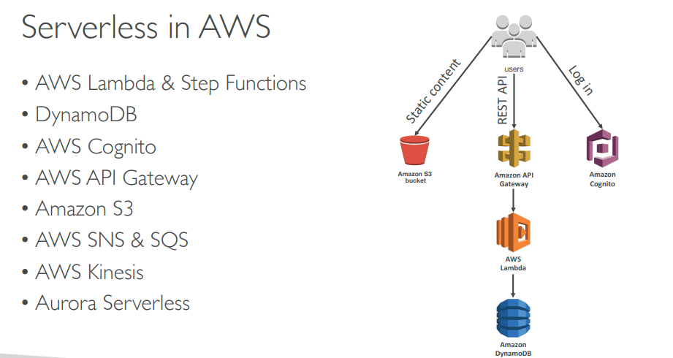

Slide 38
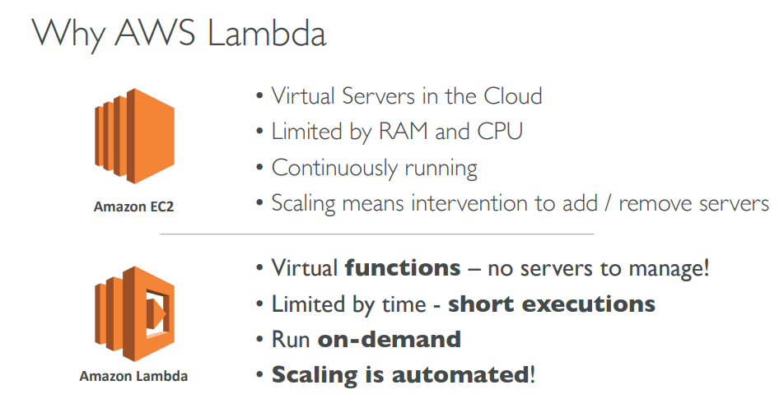

Slide 39
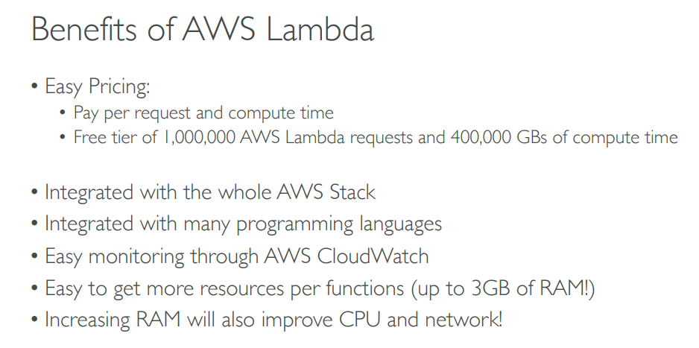

Slide 40
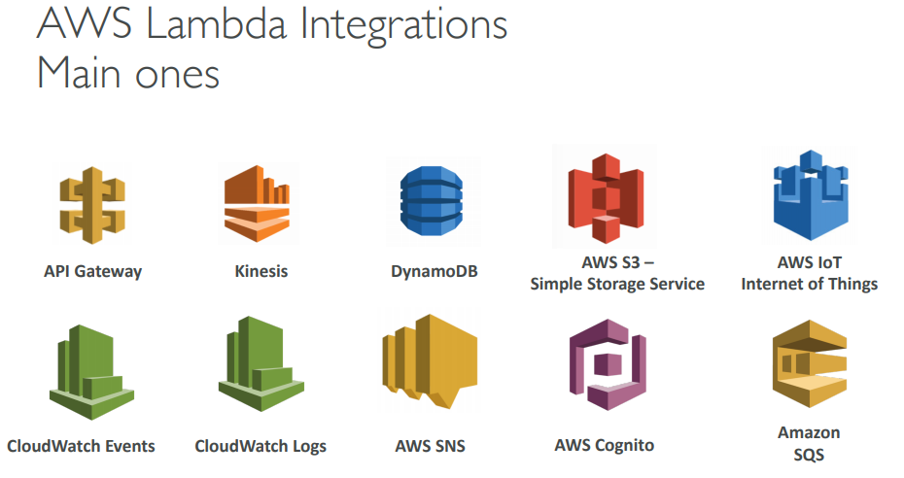

Slide 41
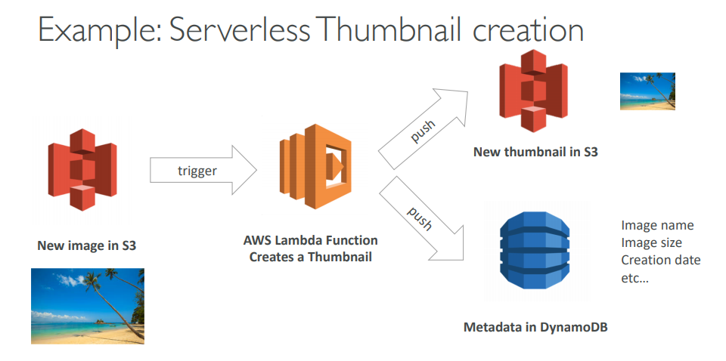

Slide 42
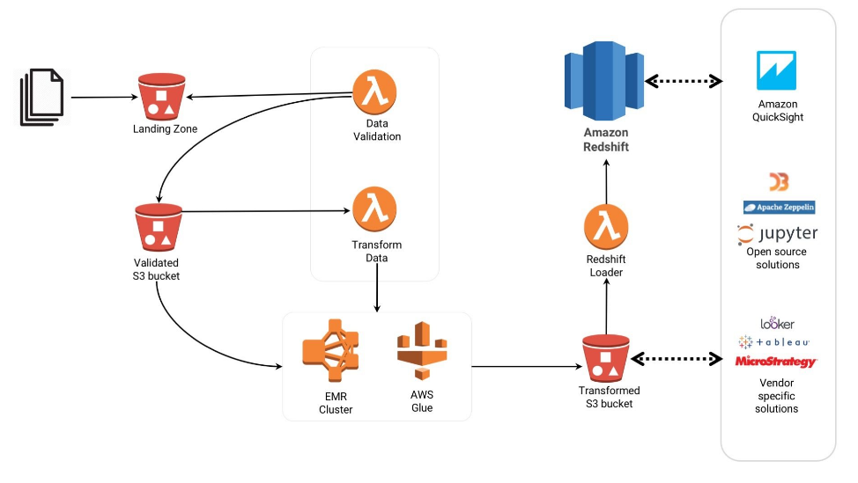
Example: ETL Workflow using AWS Lambda

Slide 43

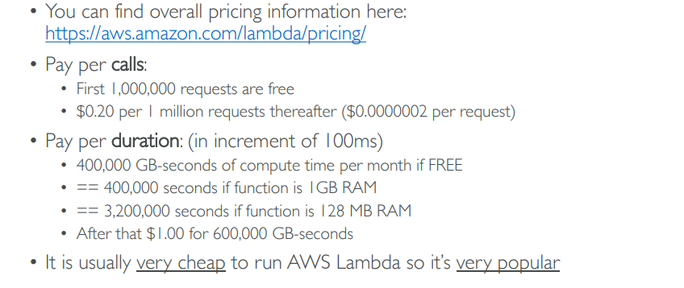

Slide 44
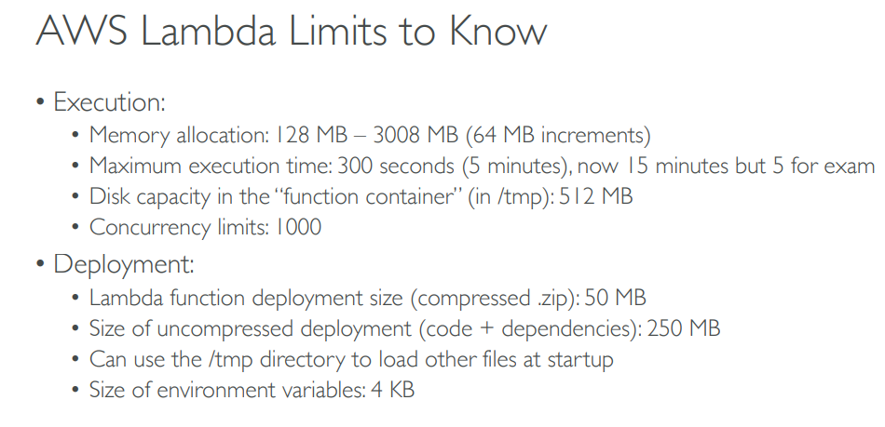

Slide 45
Useful Links

Slide 46
https://aws.amazon.com/ec2/faqs/
https://aws.amazon.com/ec2/pricing/
https://aws.amazon.com/ec2/features/
https://aws.amazon.com/ec2/instance-types/
https://aws.amazon.com/lambda/
https://aws.amazon.com/lambda/pricing/
https://aws.amazon.com/lambda/faqs/

